Slide 1


UBUNTU CHATBOT
Daljeet Kaur - C0892746
Parth Lanukia - C0895943
Mohammed Moin - C0893375
Arshpreet Singh - C0908137
Aruna Gurung - C0896129
Yash Sahu - C0895287
Chibuike Okoroama - C0892150
Jumoke Kadijat Yekeen - C0900481
Modupeola Oyatokun - C0895705
Submitted to: Bhavik Gandhi
Group: 5

Slide 2

INTRODUCTION
PROCESS
FACTS
BENEFITS
ARCHITECTURE
OUR CHATBOT
EVALUATION-METRICS
CHATBOT-DEVELOPMENT

Slide 3

What are Chatbots?
1
Conversational AI
2
Text-Based or Voice-Based
Chatbots are essentially computer programs that use artificial intelligence (AI) to engage in natural-sounding conversations with humans.
Chatbots can interact with users through text-based interfaces, like messaging apps, or voice-based interfaces, like virtual assistants.
3
Automated Interactions
4
Simulating Human Interaction
They automate tasks, answer questions, provide information, and guide users through processes, all within the framework of a conversational experience.
Chatbots are designed to mimic human conversation, using natural language processing (NLP) to understand and respond to user input.

Slide 4
PROCESS
DATA
PRE-PROCESSING
FEATURE ENGINEERING
MODEL TUNING
Embedding
Padding
Lowercasing
Tokenization
Special Character Removal
MODEL TESTING
WEB UI

Slide 5
Benefits of Chatbots
Improved Customer Experience
Increased Efficiency
Reduced Costs
Chatbots provide instant responses, 24/7 availability, and personalized interactions, leading to enhanced customer satisfaction.
Chatbots automate repetitive tasks, freeing up human agents to focus on complex issues and providing faster resolution times.
By automating tasks and handling a large volume of inquiries, chatbots can significantly lower operational costs for businesses.

Slide 6

.
TEXT CHUNKING
Challenge: we faced the issue in terms of text. So, single sentences having same means were gathered.
As the data was huge it was hard to understand it.
So, small chunks were made, starting from 100 words per chunk to 500.
It improved the efficiency, understanding and accuracy.

Slide 7
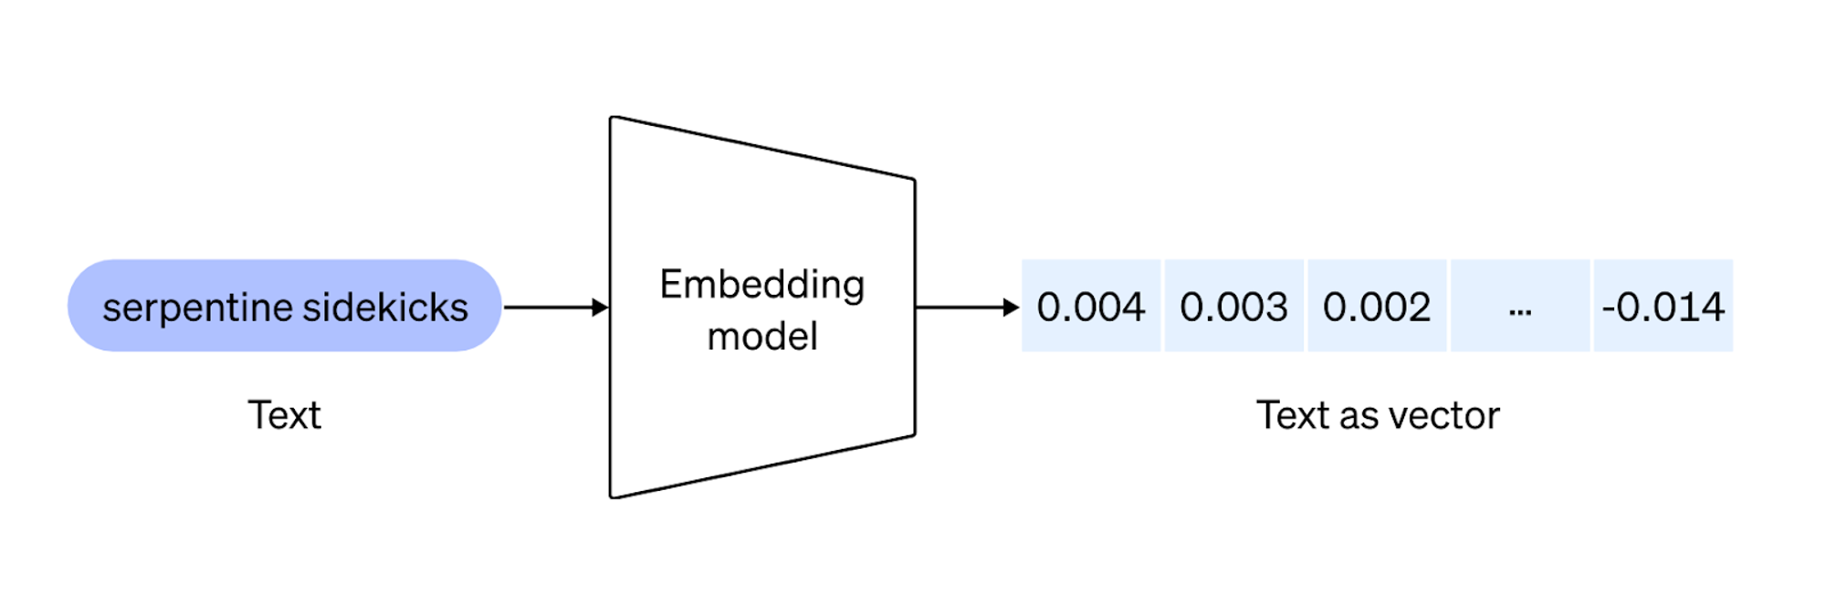
.
Building an Embedding System
Purpose: Convert text into numerical vectors.
Process:
Data preparation and cleaning.
Using pre-trained language models (e.g., BERT,LLAMA) to generate embeddings.
BERT was used however the results were not accurate.
Falcon was used for a full text file.
LLAMA was used as last as it gave better results.
Creating a FAISS (Facebook AI Similarity Search) index for efficient search which helped in conversion to numerical vectors.
Benefits: Similarity search, clustering, information retrieval.

Slide 8
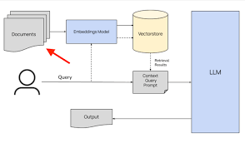
Building a chatbot using RAG System
RAG is known for its improved embedding and enhanced prompting.
Made sure model gets the most relevant information
Retrieving the most relevant chunks for queries.
Benefits: More accurate, relevant, and coherent responses.
,

Slide 9
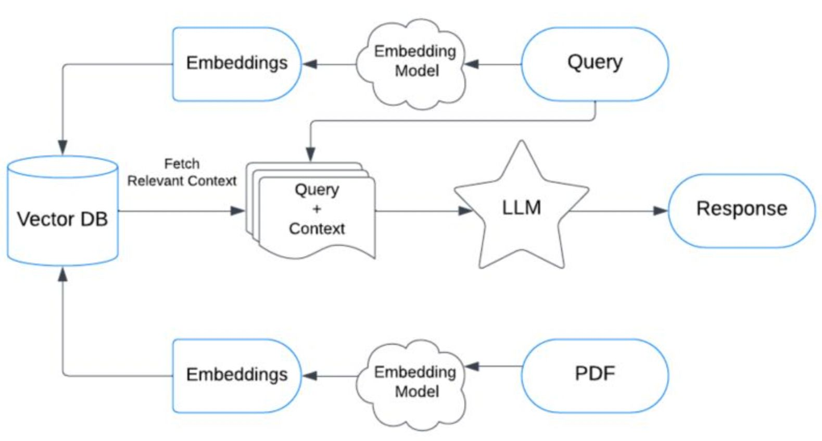
.
FLOWCHART
.

Slide 10

.
OUR CHATBOT
The RAG Chatbot is an advanced retrieval-augmented generation system that uses a combination of FAISS (Facebook AI Similarity Search) for efficient search and GPT-3.5 for dynamic response generation. It leverages a large corpus of text, like an Ubuntu manual, to retrieve the most relevant information based on a user’s query and then generate accurate, context-aware answers. The chatbot intelligently selects and combines retrieved chunks to form comprehensive responses, ensuring users receive detailed, relevant support. Designed for technical assistance, it excels in providing solutions by blending traditional retrieval methods with modern AI language modeling techniques

Slide 11
.
EVALUATION METRIC
Evaluating chatbot performance is essential to ensure responses are accurate, relevant, and fluent. This helps improve user satisfaction and aligns the bot's behavior with intended outcomes.
BERT Score: Measures how semantically similar the bot’s responses are to the reference answers by comparing embeddings. This helps capture deeper meaning beyond word overlap.
Precision, Recall, F1-Score: Metrics derived from the similarity of embeddings.
ROUGE-L: Focuses on the longest common subsequence (LCS) between the bot’s response and the reference text. It highlights the quality of the content overlap, especially in longer sequences.
Human Evaluation: (Optional) Subjective assessments of fluency, relevance, and user satisfaction. Offers qualitative insights that automated metrics may not capture.
.

Slide 12
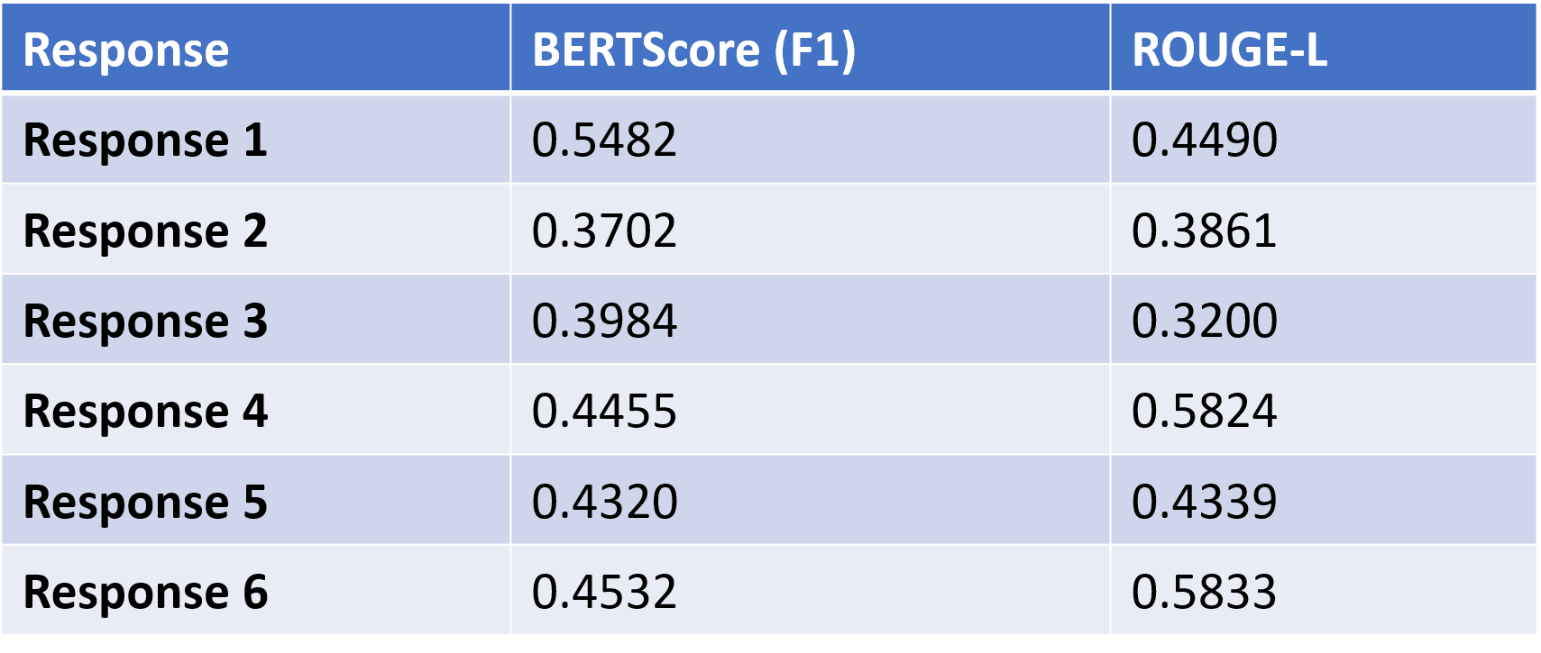
.
EVALUATION TABLE
.

Slide 13
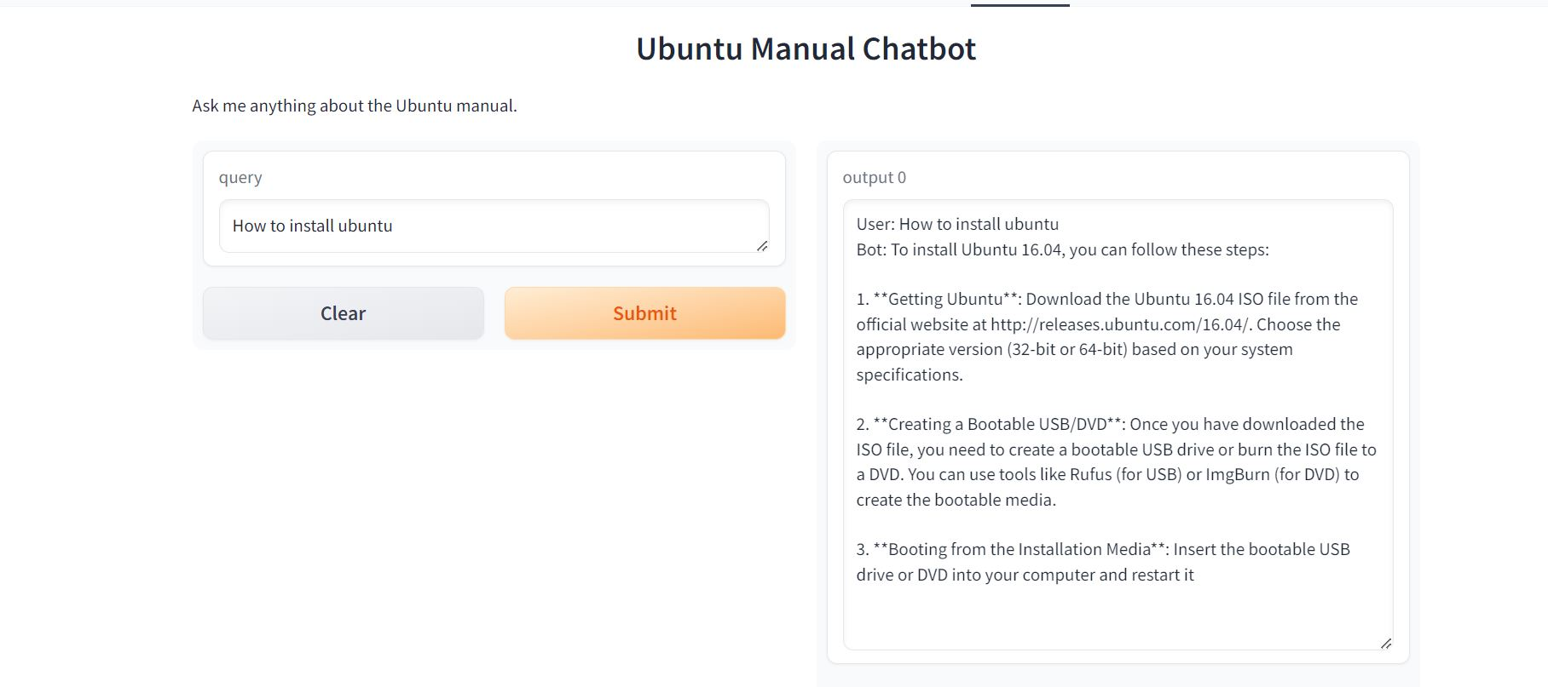
.
CHATBOT DEPLOYMENT
.

Slide 14
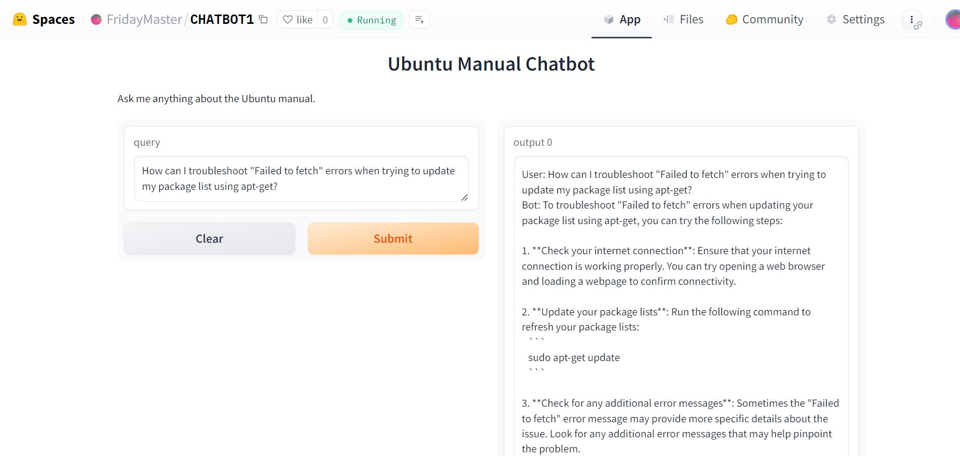
.
CHATBOT DEPLOYMENT
.

Slide 15

THANK YOU

